Slide 1


Case Study: Family Interactions in the Home
DSN2100 “GROUP” PROJECT
“TEAM” SOLO: CAITLIN ROSS, #040750891

Slide 2
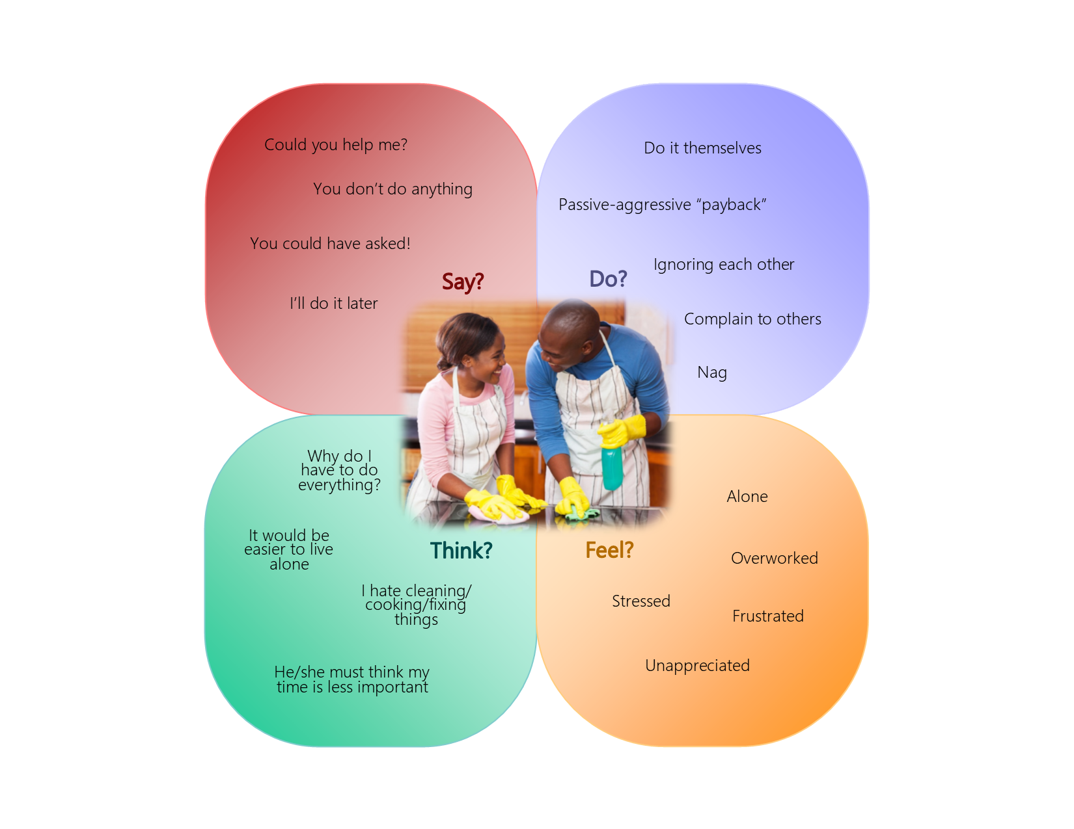
Stage 1: Empathy
Notes:
-Cannot collaborate, asking friends about their family interactions was too personal
-Decided to focus on a solution tailored for my family
-Husband brought up a good point, chores are a big issue too (rather than screens)

Slide 3
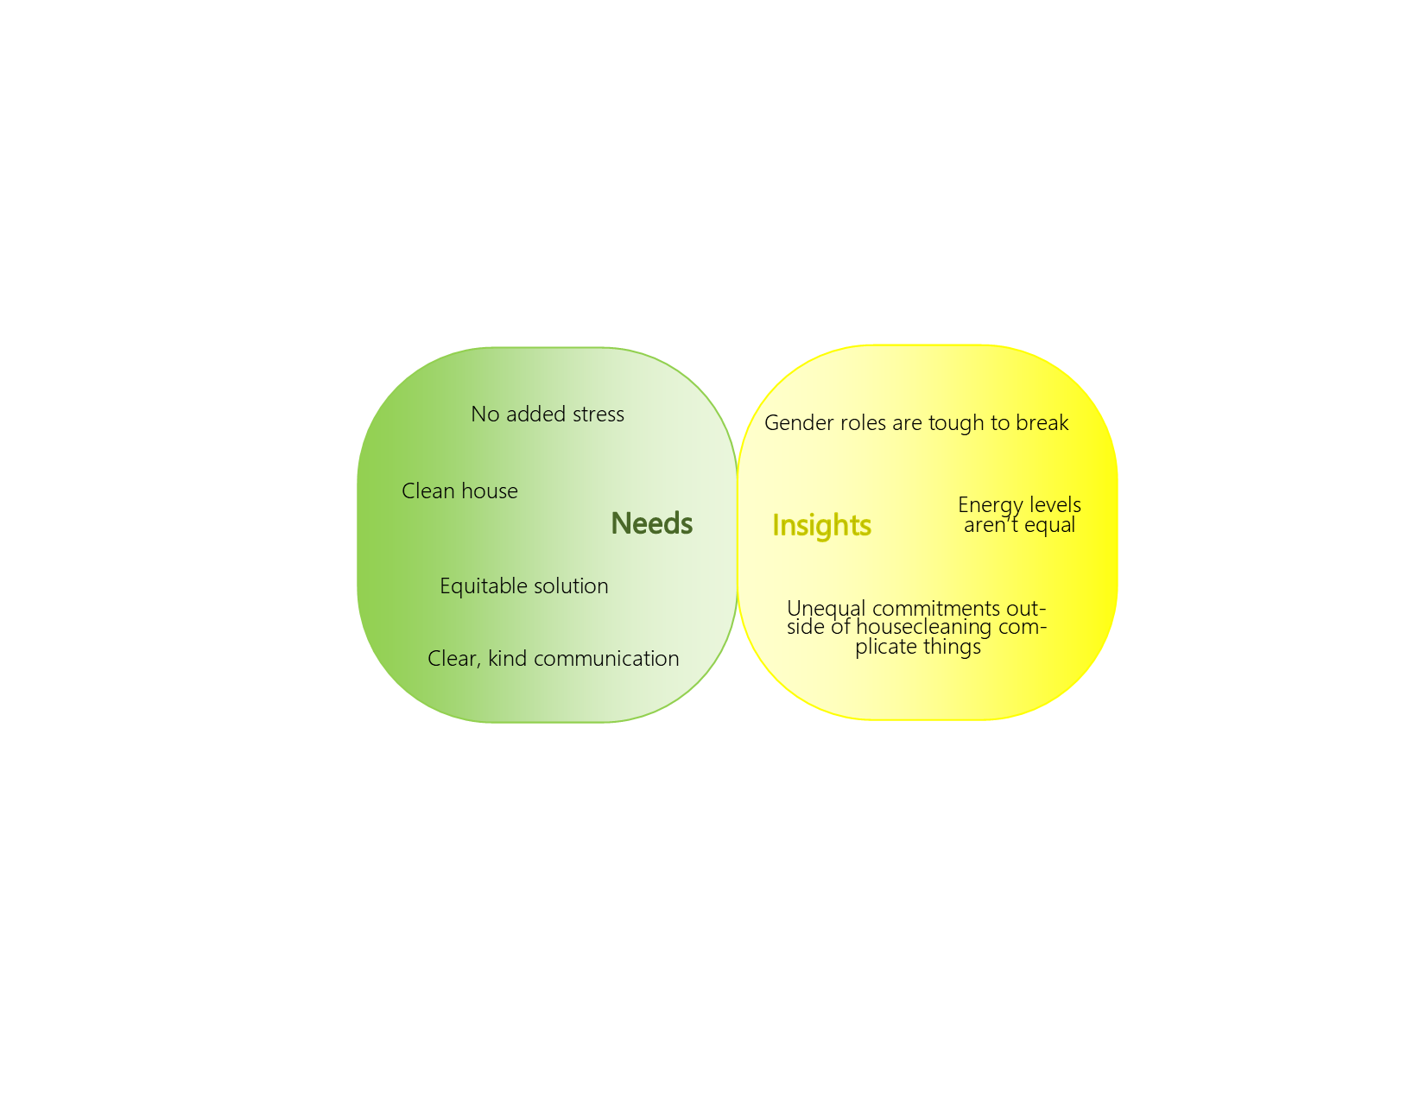
Stage 2: Problem Statement
My husband and I need a fair way to keep the house clean because we both want a cleaner home without added stress
Notes:
Complicating factors: my low energy, gender roles (and associated resentments), I’m in school, his work is erratic, land mainenance

Slide 4
Stage 3: Divergent Ideation
Make a chore list/schedule
Hire a cleaner
Make the tenants do it
Get a Roomba (and other cleaning robots)
Learn to love dirt and dust
Move to a smaller house (less area, less cleaning)
Use only disposable things to avoid dishes, laundry
Switch to a minimalist lifestyle
Notes:
Can’t afford cleaner, tenants won’t agree to clean, Roomba too expensive (also we have too many storeys), loving dirt will make us smell, Thaila will never move, disposable things are bad for environment, minimalism is a bit extreme for us

Slide 5
Stage 3: Convergent Ideation
Chore list/schedule
Notes:
And the winning idea is…
We ARE trying to minimize the number of “things” we have by reducing consumption

Slide 6
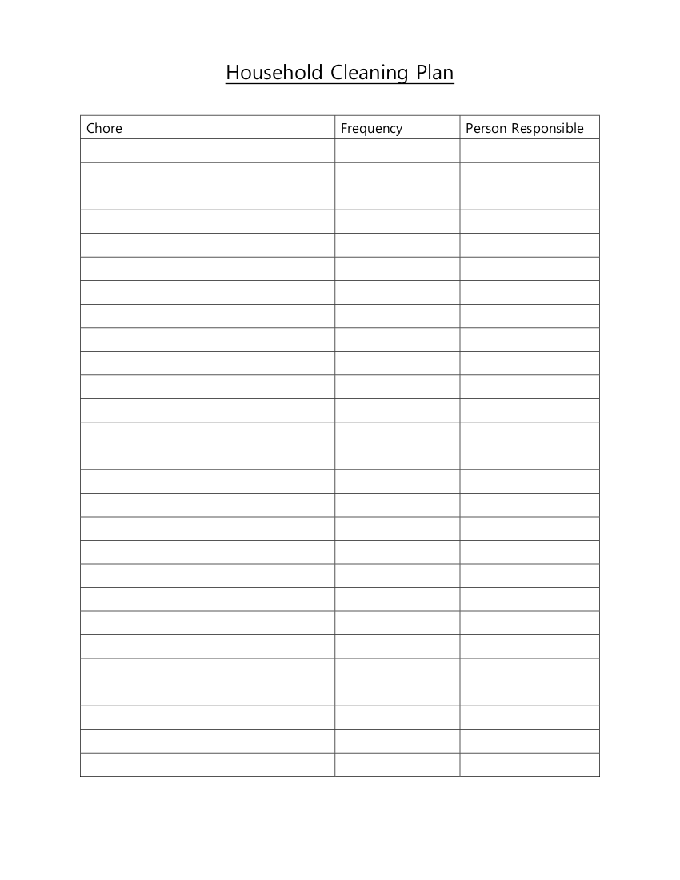
Stage 4: Prototype
Identify chores to be divvied/scheduled
Determine frequency for each chore
Decide who is responsible for each chore
Notes:
Possible enhancements: fill out a calendar, add an accountability/reward system, create an app, etc.

Slide 7
Stage 5: Testing
To be continued…

Slide 8
Sources
Empathy map persona image:
  Working Woman Report. (2016, October 13). How equal are chores in your marriage - and does it matter? Retrieved December 13, 2020, from https://workingwomanreport.com/equal-chores-marriage-matter/

